Slide 1
Notes:
If bootrun hangs with tomcat running, port 8080 will be hung and no more runs since 8080 already bound
Run from command line
C:%> netstat –ano // show PID of process listening on port 80.
C:%> taskkill /F /PID XXX // kill the task
Student guide, 4-13a and 4-13e
In Spring 1.3 spring.view.prefix and spring.view.suffic changed to spring.mvc.view.prefix and suffix

Slide 2
Advanced Spring
Extra Material
Notes:
Day 1: Setup
Name on board
Mars JEE Eclipse up with projects
AA_SpringJavaDemos
Lab01 and 01p2
Lab02, 02p2, 02p3, and 02p4
Websites
VM lab for demo: https://labs.protechtraining.com/#/
Upgrade migration from v1.3+ to v2.0: https://www.codementor.io/angularjs/tutorial/migrating-from-angular-1-to-angular-2
Gradle Java Plugin URL: https://docs.gradle.org/current/userguide/java_plugin.html
springBoot Home Page: http://projects.spring.io/spring-boot
Spring Boot Starters on the web: http://start.spring.io
Java Doc for class used in SpringBoot main: org.springframework.boot.SpringApplication

Slide 3

Core Spring Lab Manual and Presentation
You should have an email
From Clif J. Johnson <cjohnson@protechtraining.com>
Friday March 3 at 12:26 PM
Includes a link to download a zip file containing
Student Manual
Lab Manual
Now would be a good time to
Find the email
Download the documents
Open them up
You will need them Both for the Labs!
Notes:
Page 1 of lab manual should have heading
Lab 1: Setting Up the Demo Project

Slide 4
Virtual Lab Access
To Access your Virtual Lab Environment, go to
https://labs.protechtraining.com
Bookmark This Page!
Count off from 221 to 238
Remember Your Number!
Log In Now to access your own personal Virtual Environment!
UserID : PTACCESSXXX Where XXX is your number
Password : Pa$$w0rd That’s a Zero, not and ‘O’
Your Host Computer: COMPUTERXXX Where XXX is your number
Access Code: Pa$$w0rd That’s a Zero, not and ‘O’

Slide 5
Maximizing Virtual Lab Window
When connecting to your labs,
Require HTML 5 browser on your local computer
Put Browser (prior to logging in) in either
Maximized window
Full Screen Mode (preferred)
Once you log in, your resolution will be locked until you disconnect from your remote lab and reconnect at a different screen/window size.
Notes:
Maximize good because resolution probably isn’t what you’re use to on your laptop, so hard to see everything….
Full screen, or maximized?
ProTech likes Full screen…

Slide 6
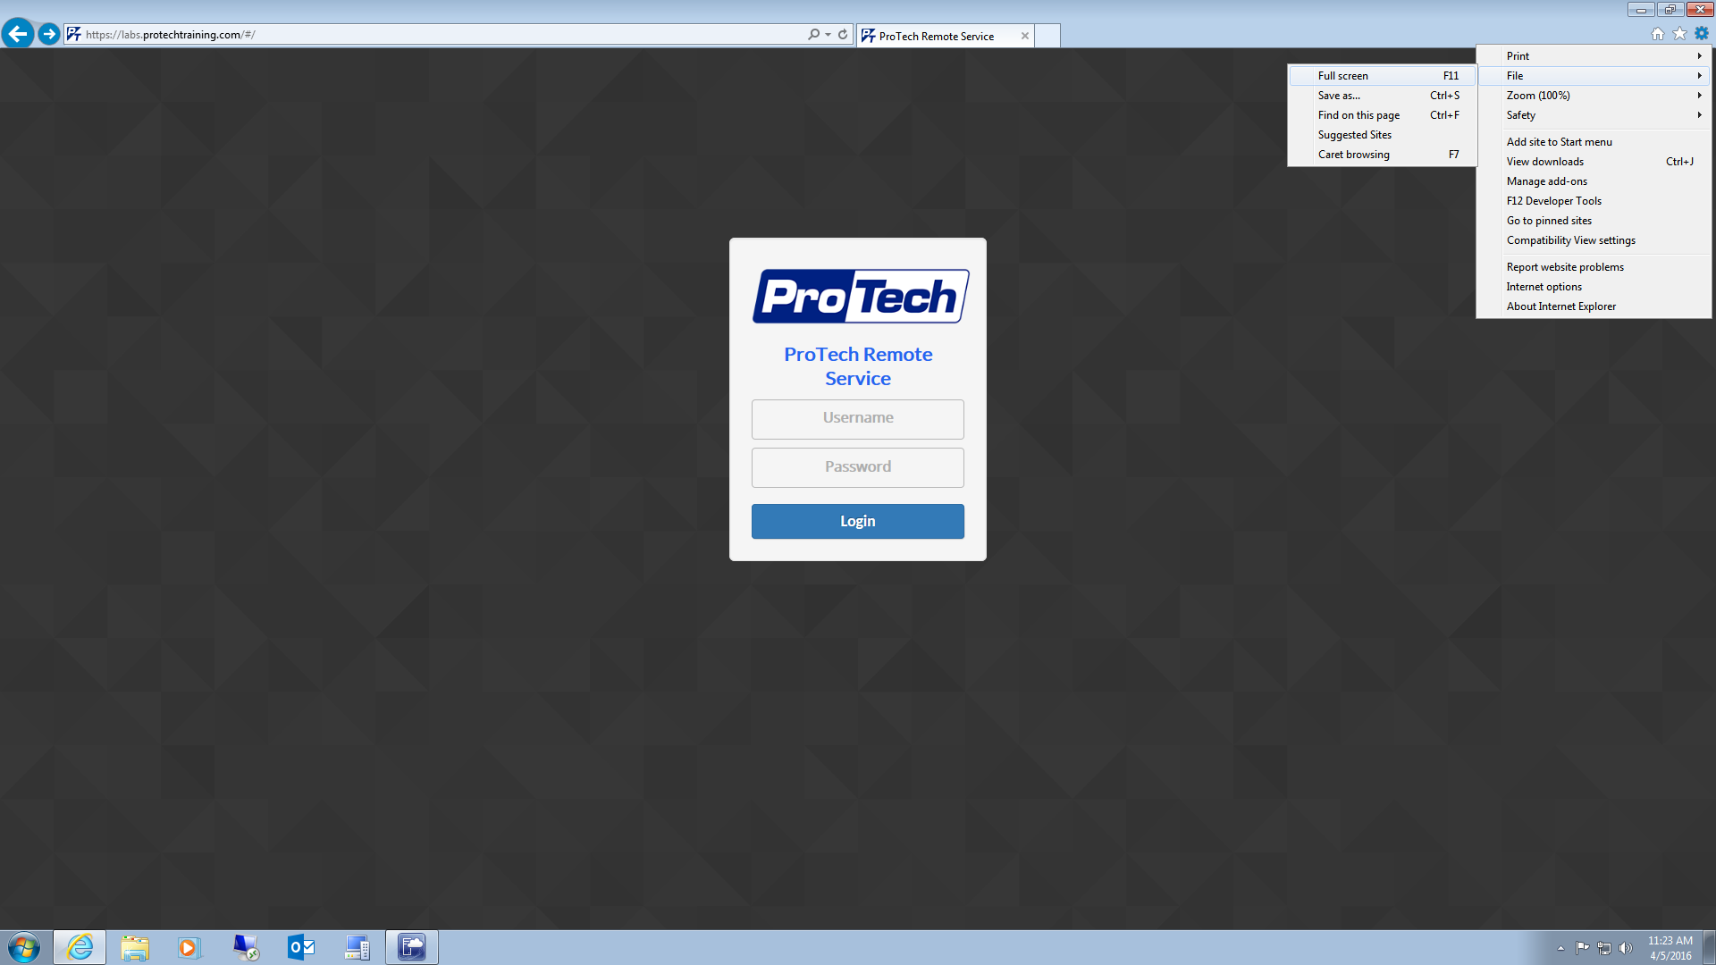
To avoid confusion with multiple task & tile bars, it is advisable to place your browser into Full Screen mode. Steps may be different based on which browser you are using. Most browsers can be toggled in and out of Full Screen mode by hitting the F11 key.
Once in Full-Screen Mode, your taskbar will disappear and your browser title bar will auto hide.
Notes:
Full screen hides your laptop taskbar,
So don’t confuse it with the virtual lab environment taskbar
Go ahead and try it by hitting the F11 key

Slide 7
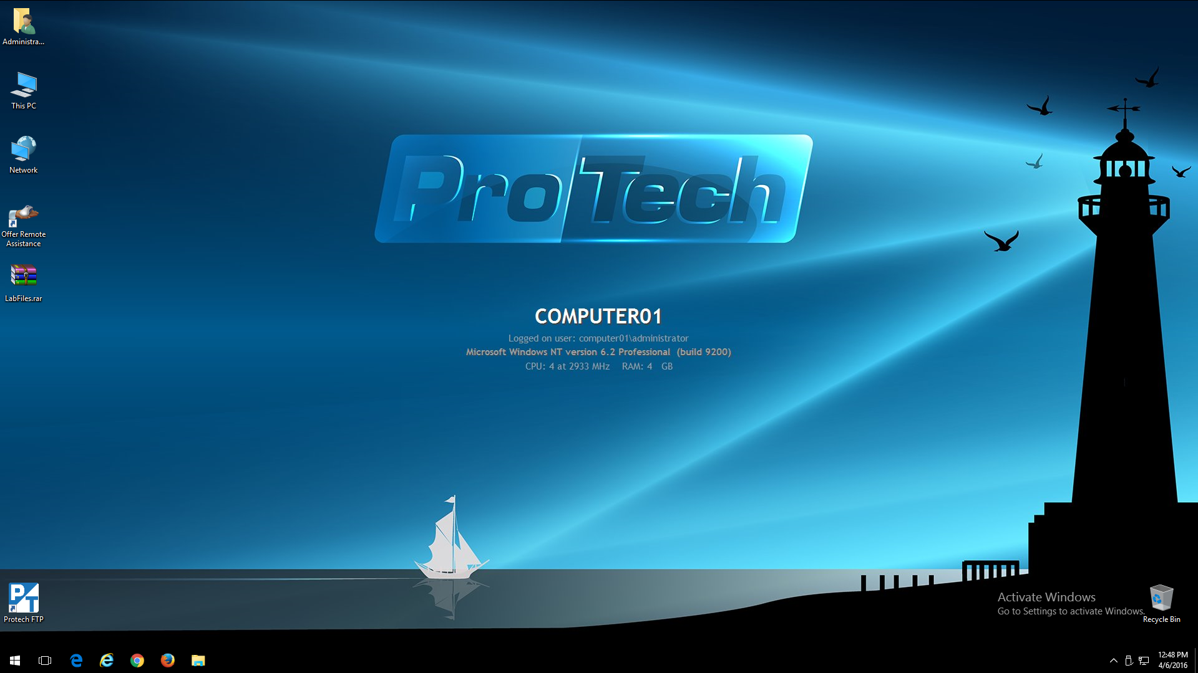
ProTech Remote Lab File Retrieval
Create a compressed archive of your lab files and place on your desktop (alphanumeric characters only, no spaces, 500MB MAX file size).
Select the ProTech FTP icon from the desktop. If the icon is not present, then this feature is not available.
Notes:
Here is the screen you’ll see
Please BE SURE your number is the one in the middle of the screen
Or you will be using someone else's environment
You are going to be doing labs all day
And will want to take your labs home with you at the end of the day
These are the ways ProTech gives you to move your files
You can also use your own cloud dropBox, iCloud, GoogleDrive, etc.
Or just zip and email it to yourself
Highly suggest you install
7_zip
Notepad++

Slide 8
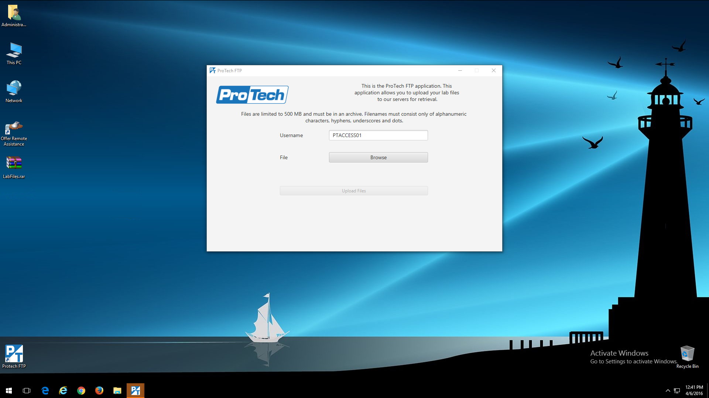
Enter your PTACCESS## or PTACCESS###
Click Browse
Notes:
If you use the ProTech FTP App you’ll use your PTAccessXXX user name and follow what it says
You will be uploading a ZIP archive to the ProTech server

Slide 9
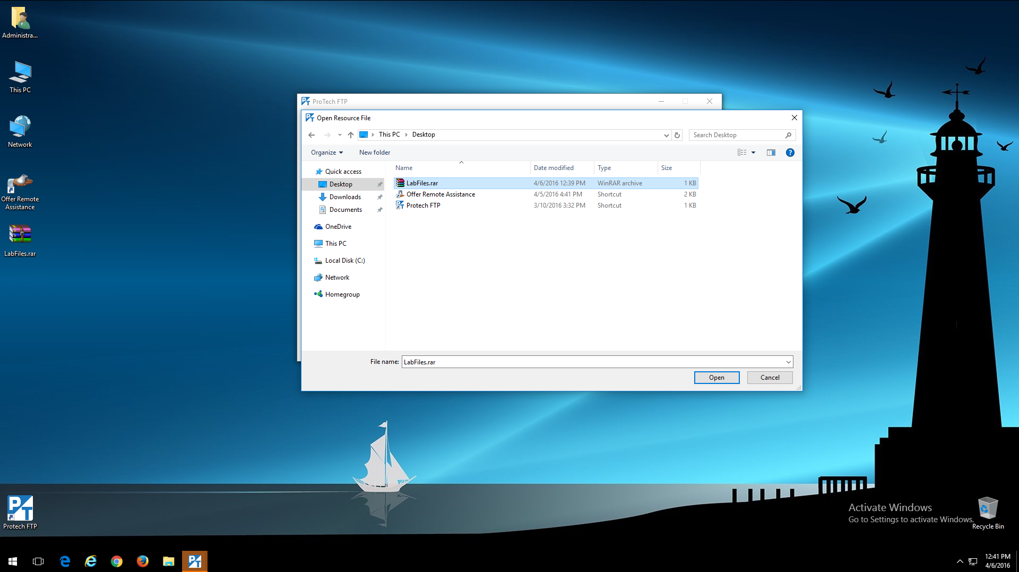
Navigate to the location of your lab file archive and click Open

Slide 10

Click Upload Files

Slide 11
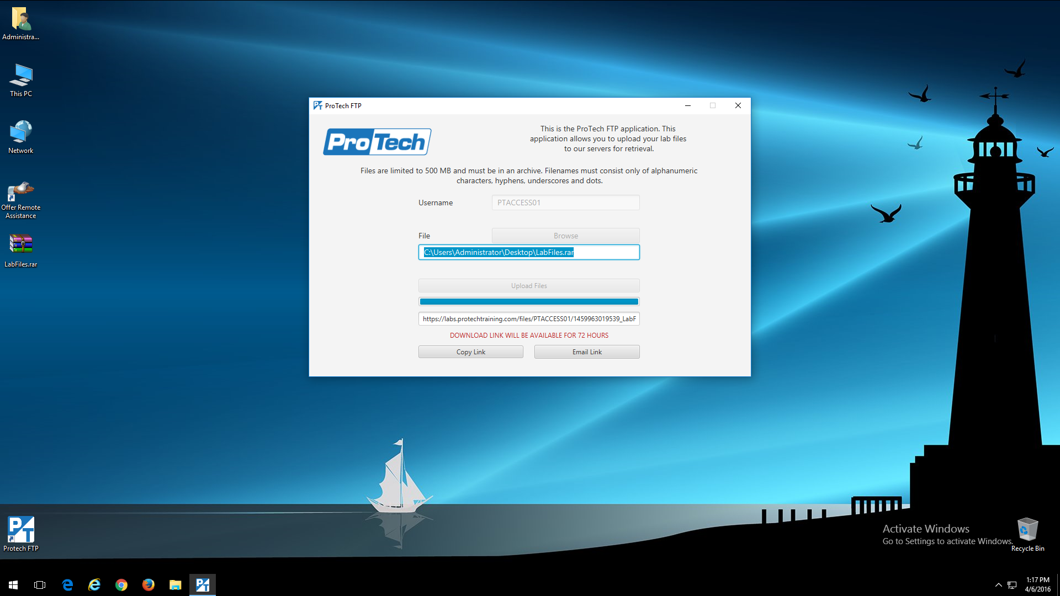
A link will be generated based on the PTACCESS ID. You can send this link to an email address, or copy and paste it using the HTML5 control panel clipboard.
Copy to HTML 5 clipboard
Send link in an email

Slide 12

Enter your email address. Personal email addresses are preferred to avoid corporate email security filters.
Notes:
Your email with the link will tell you how many days you have to retrieve your zip file from the ProTech server

Slide 13
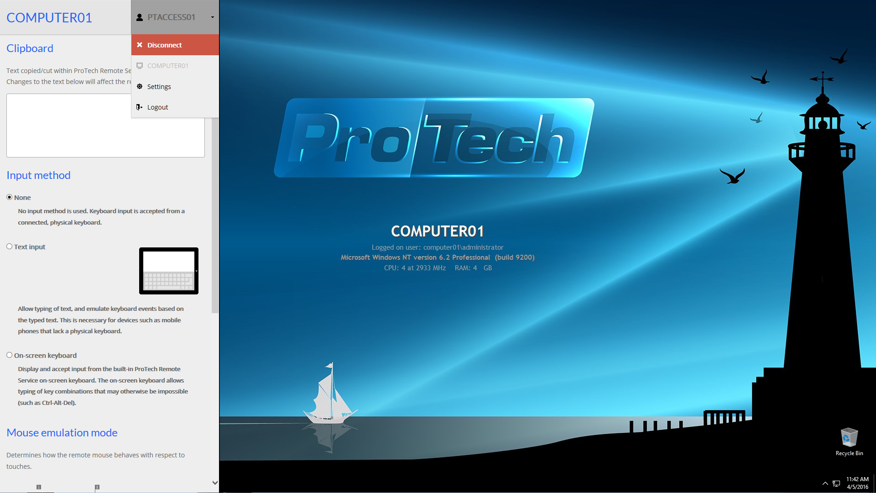
Drop down your PTACCESS ID and choose Disconnect
To display an admin panel on the left side of your screen.
Press <Ctrl><Alt><Shift> all from the left side of your keyboard.
Notes:
Ctrl-Alt-Shift from left side of keyboard
Opens up the admin panel

Slide 14
Lab Installation Locations
Base Directory: C:\Users\Administrator\
Target | Installation Directory | Access
Spring | $(Base Directory)\java\spring-1.3.1.RELEASE $(Base Directory)\java\spring-xd-1.3.1.RELEASE | File Explorer
Eclipse | $(Base Directory)\java\eclipse | Desktop Shortcut
Tomcat | $(Base Directory)\advspring\tomcat | File Explorer
Lab folders | $(Base Directory)\advspring\starters $(Base Directory)\advspring\solutions $(Base Directory)\advspring\workspace | File Explorer
LabGuide | $(Base Directory)\advspring\pdf | File Explorer
Notes:
Show:
Getting around
Shortcuts to Admin account holding tools and advspring class
Shortcut to advspring class
Show different folders in table
Getting your work off the VM by end of class
Protech FTP
How to archive
Chrome: have internet with no filtering… be good
Means can zip up your labs and send them to you Personal cloud to save your work
Probably can’t send code to your CapitalOne account

Slide 15
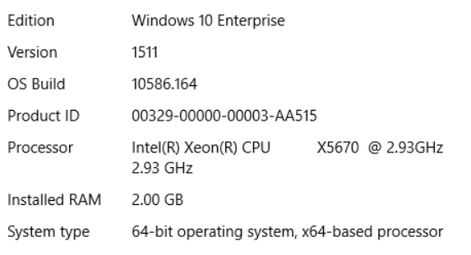
Your Tools
Your VM will be wiped out after class
So feel free to install your favorite productivity tools
7-zip
Notepadd++
Git (To upload to your GitHub repository!)
Etc…
Your VM System

Slide 16
The Application Context
More advanced than a simple BeanFactory
Adds enterprise-specific features
Derived from AbstractApplicationContext
Each child adds different capabilities
Lab01 using 2 different AbstractApplicationContext variations
FileSystemXmlApplicationContext("src/main/java/spring.xml");
Spring XML Configuration
Spring Annotation Configuration
AnnotationConfigApplicationContext (FrequentFlierConfig.class);
Spring Java Configuration
Notes:
Two MessageSource implementations:
ResourceBundleMessageSource
StaticMessageSource (rarely used…)

Slide 17
Lab 1 Introduction to Spring Boot
45 minutes Or
1:15 if need to go out to lunch
GotCha’s
Gradle is NOT installed, so do as instructions say and use gradlew instead….
Do work in : cd \Users\Administrator\advspring\workspace\lab01
No issues in lab, but try to learn the springBoot CLI!
You’ll be happy you did later….
You’ll be using WordPad to edit your build.gradle files for every lab from now on
Unless you downloaded NotePad++… ;~)
Part 2: when entering Spring Init command
Do Not put spaces between the starter dependencies, web ,thymeleaf
Notes:
If get circular dependency when run, GET method giving view “shipping” would go back to GET command
Means app isn’t finding shipping.html file, so going back to controller
Maybe misspelling in shipping.html, or in wrong folder
If lab under lab02p2/thymeleaf, , means spring init gave d=web, thymeleaf with space after comman
This will create a subdirectory for the project and not bring in the thymeleaf dependency
DeBrief:
Part 1: Basics: spring init -b 1.3.1.RELEASE --build gradle -x
org.springframework.boot.SpringApplication
Show in main, hover over import state ent to show what it does
Changes to DemoApplicaiton to repress banner,
Could be a good place to put other directives to the SpringApplication
Show JavaDoc, all the things you can do with it
2 ways to run the application, Gradle bootRun, or by running DemoApplication.java in Eclipse
Notice Controller autowire is looking for an interface called Shipping,
Remember autowire matches by type!
not the concrete class ShippingImpl
Controller: com.example.service.ShippingController
However over (implemented) CommandLineRunner to show why it runs first
Part 2: web: spring init -b 1.3.1.RELEASE -d=web,thymeleaf --build gradle -x
Controller: com.example.service.ShippingController look at POST method submitForm(model)
Attributes added to model
matches Thymeleaf expression is
src/main/resources/templates/shippingResults.html
com.example.service.ShippingController
@RequestMapping(“/shipping”)
matches post action in src/main/resources/templates/shipping.html

Slide 18
Controlling Spring Boot Auto-Configuration
Discover What auto-configuration is being applied
Start your application with the --debug switch.
Enables debug logs to write an auto-configuration report to the console
Disable Specific auto-configuration
Use the @enableAutoConfiguration “exclude” attribute
Or in Application.Properties
Use the spring.autoconfigure.exclude property
@Configuration
@EnableAutoConfiguration(exclude={DataSourceAutoConfiguration.class})
public class DemoApplication {
Notes:
use the exclude attribute of @EnableAutoConfiguration to disable them.

Slide 19
Lab 2 More Spring Boot : GotCha’s
90-120 minutes
Part 1
_6. b. Gives wrong section title
Specifies: runtime - Runtime classpath for source set 'main’
Instead Use: runtime - Runtime dependencies for source set 'main'.
Part 3 _2.
-1.f. Starter file does not contain the SQL. Most is in
Use schema.sql from lab02p2 and add the last INSERT statement
_2. Copying lap02p2 with Windows Explorer doesn’t change Eclipse to a new project. After copying,
Edit build.gradle to change baseName to lab02p3
At the command prompt in the new lab02p3 directory enter gradlew cleanEclipse, to clean all Eclipse file.
Then gradlew eclipse, to regenerate Eclipse file
_7. Cannot run within Eclipse, Must use gradlew bootrun to find db
Part 4 _1. Follow above Part 3 instructions after copy project
to reset it before importing into Eclipse
Notes:
Part 1: Working with Starter Dependencies
Dependencies: web, h2, jdbc, thymeleaf
Versions Part 1 _6 b.
org.springframework:spring-jdbc:
org.springframework:spring-jdbc:4.2.4.RELEASE
com.fasterxml.jackson.core:jackson-databind:
com.fasterxml.jackson.core:jackson-databind:2.6.4
com.h2database:h2
com.h2database:h2: -> 1.4.190
org.yaml:snakeyaml:
org.yaml:snakeyaml:1.16
_7 d. build.grandle
Remove hibernate-validator dependency from spring-boot-starter-web
if you only exclude org.hibernate from one of spring-boot-starter-web and thymeleaf,
It will not be removed
Even though spring-boot-starter-web is under thymeleaf.
Need to exclude it from both
Remove Jackson.core dependency from spring-boot-starter-web
Use specific version of h2database, 1.0.60
Exclude transitive snakeyaml and them include snakeyaml vs 1.8
Create app with controller, dao data layer, template web layer
Controller, notice Autowired on controller constructor
found CustomerDao via autoconfiguration
In memory db, so SQL used to generate and populate tables on each run
For why schema.sql got loaded:
http://www.dineshonjava.com/2016/08/working-with-sql-databases-in-spring-boot-application.html#.WKNrolMrJEY
In-memory DB, SpringBoot will look for schema.sql and data.sql files in root classpath
And automatically use them to initialize database
Spring Boot will also load schema-${platform}.sql and data-${platform}.sql files if they are available in root classpath
i.e. , data-hsqldb.sql, schema-mysql.sql…
From : https://egkatzioura.wordpress.com/2016/04/29/spring-boot-and-database-initialization/
have two datasources have to specify the datasource inject or else we will get an exception.
@Bean(name = "mainDataSource")
@Primary
public DataSource createMainDataSource() {
Run: Do boot run, in browser: http://localhost:8080/customers
Part 2: Working with Autoconfiguration and Deployment
Dependencies: web, h2, jdbc
Same webapp as part 1 minus the controller
Write new controller to be RESTful service
Add automatic 404 Not Found error
HTML and jsp now in the resources/static folder
Run: Do boot run, in browser: http://localhost:8080/customers.html
Part 3: Using an External Database
advspring\lib
Start and initialize db
java -cp hsqldb-2.3.3.jar org.hsqldb.Server -database mydb
java -cp hsqldb-2.3.3.jar org.hsqldb.util.DatabaseManager
Create table and populate it with SQL in the db manager gui
Configure app for external db
Build.gradle add hsqldb runtime dependency
Add external db properties to application.properties
Run: Do boot run, in browser: http://localhost:8080/customers.html
Part 4: Deploying as a WAR: stopped working, need to redo
Make copy of lab02p3
Change build.gradle to make a war instead of a jar
Create myServletInitialier to register Spring MVC dispatcher with Tomcat
Hover over extended SpringBootServletInitializer to see description
Create war from cmd line with gradle clean build
Install tomcat from zip
Drop war in tomcat webapps
Run:
Make sure HSQL DB is still running
Start Tomcat
Browser: http://localhost:8080/lab02p4/customers.html

Slide 20
Day 1: What Have We Learned?
Spring Core Review
What is the Spring Framework?
Spring Architecture
Introduction to Gradle
Advantages
Groovy and Build Files
Tasks, Plugins, and Dependency Management
Introduction to Spring Boot
What is Spring Boot?
Starter Projects
Autoconfiguration
Building and Running
Additional Spring Boot Topics
Starter Dependencies
Auto Configuration
Deploying a WAR
Feedback:
Class Pace:
Too fast,
Too slow
Just Right?
Content:
What did you enjoy the most
Anything Else you want to learn
Delivery:
What did you like, I’ll do more!
What can be improved?
Notes:
Setup
Websites:
Spring Boot Website: http://projects.spring.io/spring-boot
Spring Boot Initialzr: http://start.spring.io
Gradle Java Plugin: https://docs.gradle.org/current/userguide/java_plugin.html

Slide 21
Introduction to Day 2!
Day 1 topics
Today’s topics
Spring Core Review
What is the Spring Framework?
Spring Architecture
Introduction to Gradle
Advantages
Groovy and Build Files
Tasks, Plugins, and Dependency Management
Introduction to Spring Boot
What is Spring Boot?
Starter Projects
Autoconfiguration
Building and Running
Additional Spring Boot Topics
Starter Dependencies
Auto Configuration
Deploying a WAR
Spring Remoting and JMS
RMI and Spring
HttpInvoker and Spring
Messaging with JMSTemplates and Spring
Introduction to Spring Batch
Spring Batch Application Concepts
Structure and Configuration
Enterprise Integration Patterns
Overview
EIP Categories
Spring Integration
Components, Channel, and Service Activation
Messaging Gateway
Spring Integration Messages and Channels
Direct, Publish Subscribe, and Queue Channels
Notes:
Day 1: Setup
Websites
Picture of queuing providers:
https://www.ibm.com/support/knowledgecenter/zosbasics/com.ibm.zos.zmidwebs/zmiddle_117.htm
Bring up JavaDoc to show implemented
ItemReader: http://docs.spring.io/spring-batch/trunk/apidocs/org/springframework/batch/item/ItemReader.html
ItemWriter: http://docs.spring.io/spring-batch/trunk/apidocs/org/springframework/batch/item/ItemWriter.html
EIP Book homepage:
Homepage: http://www.enterpriseintegrationpatterns.com/
Patterns with diagram: http://www.enterpriseintegrationpatterns.com/patterns/messaging/index.html

Slide 22
Lab 3 Spring and JMS
60 minutes
GotCha’s
_3. b. Not in the buildscript { repositories {…}}
Put in the repository list in lower half of build.gradle file
repositories {
mavenCentral()
maven{ url 'http://repository.jboss.org/nexus/content/groups/public'}
}
Notes:
DeBrief:
Part 1: Spring and JMS spring init d=web,hornet,thymeleaf
Enable hornet JMS messaging provider
Build.gradle: added hornet dependency to repository
Note hornetq spring boot starter
Add queue configuration to application properties
Add purchase Order to domain
Part 2: Creating the Messaging Layer
Package: com.example.messaging using JmsTemplate
SendPurchaseOrder with MessageCreator
MessageCreator not really needed since sending an object
ReceivePurchaseOrder implementing MessageListener
Config class com.example.MyConfiguration
Bean: ConnectionFactory
Bean: MessageListener
Part 3: Creating the Web Layer
MVC Controller: com.example.controllers.POController
GET returns view po
Post returns view sendresults and sends message vis jms sender
Resources/template
po.html
Sendresults.html
Run: involves both application console and browser
Bootrun the application to start embedded tomcat with app
Browser : http://localhost:8080/sendpo
Get back msg to look at command prompt output for PO Info

Slide 23
Spring Batch Scaling
Home Grown, No Framework Support
Partitioning data in a logical way
Run multiple jobs against the various partitions
You manage what jobs are running against which data
Spring Framework Gives Two modes of Parallel Processing
Single Process, Multi-threaded
Multi-threaded Step
Parallel Steps
Multi-process
Remote Chucking of steps
Partitioning a Step
http://docs.spring.io/spring-batch/trunk/reference/html/scalability.html
Notes:
http://docs.spring.io/spring-batch/trunk/reference/html/scalability.html

Slide 24
Spring Batch Single Process, Multi-Threaded
Multi-threaded Step
Use TaskExecutor
Each Chunk of items executes in a separate thread of execution.
Multiple chunks processing in parallel
Means no fixed order for item processing
Parallel Steps
Use Flows to groups steps of a single Job
Flows run in parallel, so single job finished quicker
http://docs.spring.io/spring-batch/trunk/reference/html/scalability.html
Notes:
http://docs.spring.io/spring-batch/trunk/reference/html/scalability.html

Slide 25
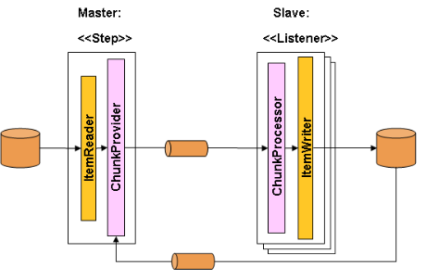
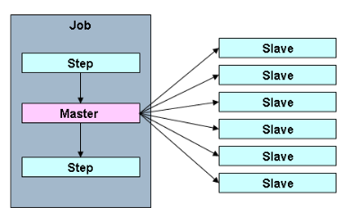
Spring Batch Multi-Process
Remote Chucking of Steps
Split step processing across processes
1 Master and multiple Slaves
Com. must be durable with guaranteed delivery
Partitioning a Step
Parallel steps part of a fabric
Can be remote of multiple threads
Splitter and Aggregator EIP
Good for IO intensive Steps
E.g. copy or replicate large number of files
http://docs.spring.io/spring-batch/trunk/reference/html/scalability.html
Notes:
http://docs.spring.io/spring-batch/trunk/reference/html/scalability.html

Slide 26
Lab 4 Spring Batch
120 minutes
GotCha’s
Part 1 _7. a. for class Job import use interface
org.springframework.batch.core.Job
Part 2
_2. don’t forget to change the baseName in build.gradle
_14. a. for class Job import use interface
org.springframework.batch.core.Job
_15. Cannot run within Eclipse, Must use gradlew bootrun to find db
Part 3: Most of the methods you need to write are from the implemented interfaces
Use Eclipse right click: Source -> Override/Implement Methods…
To create prototype for you
Notes:
DeBrief:
Part 1: simple Spring Batch, spring init d=batch, hsql
Main class: com.exampleBatchConfiguration:
The @EnableBatchProcessing annotation enables Spring Batch
And sets up a base configuration, including
a JobRepository,
JobLauncher,
JobRegistry and job and step factories.
You can then autowire these into your program.
Notice all the Spring Beans
Step and Job factories
Steps (step1 and step2) and Job
Tasklets are a unit of work within a step
use injected StepBuilderFactory to create a StepBuilder,
assign the tasklet and retrieve a TaskletStepBuilder:
Use the TaskletStepBuilder to create the step object and return it:
Configure job with incrementer (DB Id)
Start steps one at a time, returning a SimpleJobBuilder
Use SimpleJobBuilder to build and return the job
Run: Bootrun, or as Java app from within Eclipse
no explicit database for jobRepository, but added hsql, so provided an in memory one
Part 2: Processing Input and Generating Output Add Repository Database ! spring init d=batch, hsql
Build.gradle: add compile ('commons-dbcp:commons-dbcp:1.4')
Use Apache Commons Database Connection Pooling
Find SQL Schema for job repository for given database
In Referenced Libraries folder, find the Spring batch core (spring-batch-core-3.0.5.RELEASE.jar}
Expand and find org.springframework.batch.core
Expand and scroll to fine schema-hsqldb.sql, double click to open
Start and configure database
advspring\lib
Start DB: java -cp hsqldb-2.3.3.jar org.hsqldb.Server -database mydb
Start GUI DBMgr: java -cp hsqldb-2.3.3.jar org.hsqldb.util.DatabaseManager
Setup account table and schema-hsqldb.sql job repository schema
Data for account in account.csv
Application.properties disable automatic running of database scripts
spring.batch.initializer.enabled=false
Add code
domain: com.example.Account
Config: com.example.BatchConfiguration
Normal beans JobBuilderFactory, StepBuilderFactory, Steps, Job
Step not just doing tasklet
Actually configuring source and sink objects
New beans: DataSource, ItemWriter, LineMapper, ItemReader
Run: run from cmd line Bootrun, Cannot run from within Eclispe
Go to HSQL GUI and enter
Select * from account to see rows from CVS data
Select * from batch_job_execution to see rows of job execution
Part 3: Custom Item Reader and Writer
Add domain
Domain objects com.example.domain.Game
Add data in games.txt with data of 3 games (date and 2 team names in each)
Add code:
Customer reader and writer: com.example MyItemReader, MyItemWriter
Main class: com.example BatchConfiguration
@Bean methods for MyItem Reader and Writer
Use them in configuring step
Run: Bootrun, or as Java app from within Eclipse

Slide 27
Lab 5: Introduction to Spring Integration
40 minutes
GotCha’s
None! Have Fun!
Notes:
DeBrief:
Tomcat Jasper is the embedded JSP engine
Both part 1 and part 2 are in the same project in different packages
So have 2 main() methods, and can’t run from command line
Just run from Eclipse, 2 mains so can’t run from command line
Part 1: Hello World from Spring Integration Application Spring init d=integration
This is the hard way, client knows about messaging
Service sayHello and HelloWorldImpl
Java Configuration Class com.example.IntegrationConfiguration
@EnableIntegration
Return beans
hello
shippingChannel
activator(): service activator of hello and shippingChannel
Main method
Use ctx to get channel and send message to channel
Set logging level to warn
Part 2: Using a Messaging Gateway Spring init d=integration
Easy way, client is slim dumb and happy
configure a Messaging Gateway that encapsulates your Hello, World service,
so the calling program can use the service's native API instead of explicitly sending messages.
HelloWorld I/F
modify the service
returns the String instead of directly printing it to the console.
@MessagingGateway(defaultRequestChannel="shippingChannel")
Configures I/F as messaging gateway,
spring will create a proxy for the I/F to call the service over the channel
IntegrationConfiguration class
Add @IntegrationComponentScan("hello")
to find lasses and I/F that act as integration components
Use ServiceactivatingHandler which returns a response from the f’ct call
DemoApplication main: make it easy to use the proxy
No knowledge of channels required

Slide 28
Day 2: What Have We Learned?
Spring Core Review
What is the Spring Framework?
Spring Architecture
Introduction to Gradle
Advantages
Groovy and Build Files
Tasks, Plugins, and Dependency Management
Introduction to Spring Boot
What is Spring Boot?
Starter Projects
Autoconfiguration
Building and Running
Additional Spring Boot Topics
Starter Dependencies
Auto Configuration
Deploying a WAR
Annotations
Spring Remoting and JMS
RMI and Spring
HttpInvoker and Spring
Messaging with JMSTemplates and Spring
Introduction to Spring Batch
Spring Batch Application Concepts
Structure and Configuration
Enterprise Integration Patterns
Overview
EIP Categories
Spring Integration
Components, Channel, and Service Activation
Messaging Gateway
Feedback:
Class Pace:
Too fast,
Too slow
Just Right?
Content:
What did you enjoy the most
Anything Else you want to learn
Delivery:
What did you like, I’ll do more!
What can be improved?

Slide 29
Introduction to Day 3
Spring Core Review
What is the Spring Framework?
Spring Architecture
Introduction to Gradle
Advantages
Groovy and Build Files
Tasks, Plugins, and Dependency Management
Introduction to Spring Boot
What is Spring Boot?
Starter Projects
Autoconfiguration
Building and Running
Additional Spring Boot Topics
Starter Dependencies
Auto Configuration
Deploying a WAR
Spring Remoting and JMS
RMI and Spring
HttpInvoker and Spring
Messaging with JMSTemplates and Spring
Introduction to Spring Batch
Spring Batch Application Concepts
Structure and Configuration
Enterprise Integration Patterns
Overview
EIP Categories
Spring Integration
Components, Channel, and Service Activation
Messaging Gateway
Spring Integration Messages and Channels
Direct, Publish Subscribe, and Queue Channels
Integration Endpoints
Messaging, Inbound, and Outbound Endpoints
Gateways and Routers
Splitters, Aggregators, Filters, and Transformers
Introduction to Hadoop
HDFS
MapReduce
YARN
Introduction to Spring XD
Streams, Sources, and Sinks
Processors and Tags
Tools
Spring XD Modules
Sources, Sinks, and Processors
Taps, Counters, and Guages
XD Jobs
Notes:
SETUP: Have open in browser
Lab 7 ExtraInfoLap07MsgFlow.jpeg,
Direct student to it in their lab manuals
BEFORE starting 1st modules, Spring Integration Endpoints
ExtraInfoMapReduceDiagram: needed for Hadoop module
Spring XD have server and cmd up and running (see setup for lab 8)
So can do a "module list" command to see available modules
Leave it up to show it while going through each slide in Spring XD Module Overview
Websites:
AbstractMessageHandler Javadoc
http://docs.spring.io/autorepo/docs/spring-integration/3.0.8.RELEASE/api/org/springframework/integration/handler/AbstractMessageHandler.html
ServiceActivatingHandler
http://docs.spring.io/autorepo/docs/spring-integration/3.0.8.RELEASE/api/org/springframework/integration/handler/AbstractMessageHandler.html
Haddop Google paper bad link in mats: good link at https://static.googleusercontent.com/media/research.google.com/en//archive/mapreduce-osdi04.pdf
Haddop History table at : https://en.wikipedia.org/wiki/Apache_Hadoop
Spring SD Sources : http://docs.spring.io/spring-xd/docs/1.3.0.RELEASE/reference/html/#sources
Spring SD Sinks: http://docs.spring.io/spring-xd/docs/1.3.0.RELEASE/reference/html/#sinks
SpringXD Reference Guild:
http://docs.spring.io/spring-xd/docs/current/reference/html/#_reference_guide
Video:Martin Fowler at GO 2012 overview of NoSQL databases
Start at 9:36
End when done with aggregate types of databases
https://www.youtube.com/watch?v=qI_g07C_Q5I

Slide 30
Lab 6: Messages and Channels
90 minutes
GotCha’s
Part2:
In one process, so everything using the same account reference
Be sure to instantiate a different account object for each message
Or message in queue will “Mysteriously” change values ;~)
Publish Subscribe code is not in the Solutions
But it’s pretty easy, so shouldn’t need solution…
Use either the MethodInvokingMessageHandler or the ServiceActivatingHandler ServiceActivator for the subscribers
Don’t forget to stop the HSQLDB Database and GUI when you are done!
Notes:
DeBrief:
Part 1: Using Point-to-Point Channels
Spring boot d=integration
Code
Domain: account
Service: AccountService.accrueInterest(Account a)
Config: IntegrationConfiguration
Spring Integration Components
Point-Point direct channel, AccountChannel
Service Activator talk to ProcessAccount.accrueInterest()
Add header to msg with @Header in AccountSrviceImpl
Run: as java app from main, displays original and updated balance after accruing interest
Part 2: Adding a Publish-Subscribe Channel
Use part 1 as starting point
If don’t get error due to no poller
Then misspelled bean name in either configuration or getBean
With Auto-configuration will look on class path
See Spring Integration
Create a channel, defaults to DirectChannel
Modify Service I/F and impl to return updated account
Add services (I/F and impl) for Audi and Email service
Both take the modified account
Update Java Configuration
Add @Bean method to create the email and the audit service
Make changedAccountChannel bean
Make it a Publish Subscribe channel
Write a @Bean serviceActivator configurator for both the email and the audit service
Set changedAccountChannel as the input channel
Have existing serviceActivator for accountChannel call accrueInterest,
Capture returned ServiceActivatingHandler
Set returned ServiceActivatingHandler with output channel changedAccountChannel
And return the serviceActivatingHandler
Run: as java app from main, displays :
original and updated balance after accruing interest
Email service getting updated account
Audit service passing 1st account and failing the 2nd one

Slide 31
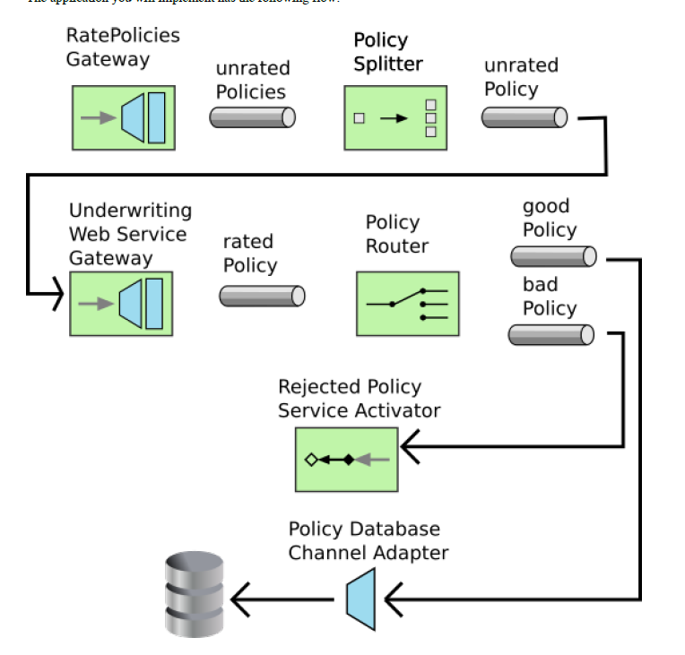
Lab07 Message Flow

Slide 32
Lab 7: Endpoints
90 minutes
GotCha’s
Part 1,
-1. b. command to start DB is slightly different than last time
_1. f. Lab07 starters does not contain the SQL, just type it in
Part2,
_1. c. Be sure to create a “file”, not a “class”.
Filename package.info is not a valid class name.
Don’t forget to stop the HSQLDB Database and GUI when you are done!
Notes:
DeBrief:
Note if a flow does not have an endpoint, you get an error
A no subscriber error
This may be important to know when you get errors working with spring-xd
SETUP and CONFIG
Start and configure externals: database: \advspring\lib
Start database: java -cp hsqldb-2.3.3.jar org.hsqldb.Server -database lab07db
Start GUI DBMS: java -cp hsqldb-2.3.3.jar org.hsqldb.util.DatabaseManager
Create policy table with SQl in Lab top of page Page 7-3
Import and start the Rate Policy SOAP Web Service
Import PolicyWebService jar file into Eclipse
PolicyService.ratePolicy() is a JAX-WS SOAP Web service
Run PolicyPublisher.java as Java application to start the Web Service
SPRING INIT APP
Spring init d=integration
Gradle add dependencies for hsqldb, spring-integration-ws, and spring-integration-jdbc
Rate Policy SOAP Web Service
Domain: InsurancePolicy same as in message flow
JAX-B @XmlRootElement with @XmlRegistry ObjectFactory class
Add package-info.java file: used by Spring web service gateway to create XML SOAP msg
Published by PolicyPublisher
Work done in PolicySevice
WebMethod insurancePolicy
MessageFlow:
Configuration : IntegrationConfiguration
Bean
RejectedPolicyRouter
Message Gateway
RatePolicies (client gateway, keep clients ignorant of messaging)
WebServices to invoke RatePolicy Web service
ServiceActivator on input unratedPolicyChannel
Create MarshallingWebServiceOutboundGateway
Set output channel as ratedPolicyChannel
DirectChannel:
unratedPoliciesChannel
unratedPolicyChannel
RatedPolicyChannel
jaxb2Marshaller for InsurancePolicy marshal to XML
serviceActivator
RejectedPolicyService endpoint
Input : badPolicyChannel
Output: MethodInvoingMesageHandler for RejectedPolicyService endpoint
approvedPolicyActivate:
Input : goodPolicyChannel
Output: JDBC outbound channel adapter
DataSource: HSQL DB: JDBC Outbound Channel Adapter
Main: DemoApplication getBean(RatePolicies.class) as rater
Create collection of InsurancePolicies as input data
Service: PolicySplitter splits collection into individual policies
Annotations @MessageEnpoint class and @Splitter method
Input from ratedPoliciesChannel
Add outputChannel, unratedPolicyChannel to splitter method
Service PolicyRouter,
Annotations @MessageEnpoint class and @Router method
Input from ratedPolicyChannel
send approved policies to goodPolicyChannel
send reject policies to one badPolicyChannel
Service RejectedPolicyService: final enpoint
Run:
Run PolicyPublisher.java as Java application to start the Web Service
Run Message from command line using bootrun
See approved policy on cmd line
Look in GUI DBMS,
enter select * from Policy
See approved policy put into database

Slide 33
Lab 8: Introduction to Spring XD
25 minutes
GotCha’s
Part1 _3. To avoid line wrap in the Spring XD cmd prompt
Open the properties on the command windows
Set Layout->Screen Buffer Size->Width to 190
Otherwise: None! Have Fun! :~D
Notes:
DeBrief:
Put commands in XD command window and go over them
Point out difference between getting info on source:time and sink:log
XD differentiates between sources and sinks

Slide 34
Lab 9: XD Modules
15 minutes
40 minutes with Challenge!
Download your Labs!
GotCha’s
Writing the stream cmd in a text editor and copy it into the XD Shell window
Makes it easier to correct typos, since cmd will be long enough to wrap!
Part 1: _1. b. Command to start database is slightly different than in lab07
Part1 _2. As in the lab08, to avoid line wrap in the Spring XD cmd prompt
Open the properties on the command windows
Set Layout->Screen Buffer Size->Width to 190
_7. File is in C:\tmp\xd\output
Sometimes the cmd window hangs when destroying the stream
May need to start a new Spring XD
Use the GUI to destroy the stream to avoid this
Don’t forget to stop the HSQLDB Database and GUI when you are done!
Notes:
DeBrief:
xd:>stream create --name processAccount
--definition
"jdbc --url=jdbc:hsqldb:hsql://localhost:9002/ --query='select * from account'
--username=sa --fixedDelay=100 |
filter --expression='payload.balance > 0.00 && payload.open == TRUE‘
| file --suffix=log" –deploy
xd:>stream create --name processAccount --definition "jdbc --url=jdbc:hsqldb:hsql://localhost:9002/ --query='select * from account' --update='update account set newrow=false' --username=s| f
ilter --expression='payload.newrow == TRUE' | file --suffix=log" --deploy

Slide 35
Lab 9: XD Modules Filters
Use JDB, Filter out 0 balance accounts and closed accounts
xd:>stream create --name processAccount
--definition
"jdbc --url=jdbc:hsqldb:hsql://localhost:9002/ --query='select * from account'
--username=sa --fixedDelay=100
| filter --expression='payload.balance > 0.00 && payload.open == TRUE‘
| file --suffix=log" –deploy
xd:>stream create --name processAccount --definition "jdbc --url=jdbc:hsqldb:hsql://localhost:9002/ --query='select * from account' --update='update account set newrow=false' --username=s| filter --expression='payload.newrow == TRUE' | file --suffix=log" --deploy
Notes:
Spring XD Installation directory: /Users/username/java/spring-xd-1.3.0.RELEASE
Xd/bin/xd-singlenode.bat
Shell/bin/xd-shell.bat
Start the Spring XD Web GUID : http://localhost:9393/admin-ui
Log file in c:/tmp/xd/output

Slide 36
Lab 9: XD Modules Challenge
Use JDB, Filter on New Rows, Update New Row column to True, print output to log file
xd:>stream create --name processAccount
--definition
“jdbc --url=jdbc:hsqldb:hsql://localhost:9002/ --query='select * from account‘
--update='update account set newrow=false' --username=s
| filter --expression='payload.newrow == TRUE'
| file --suffix=log" --deploy

Slide 37
Spring XD => Spring Cloud Data Flow
Announced During SpringOne2GX 2015 Conference by Pivotal
Complete re-archecture to overcome limitations in Spring XD
Scaling capabilities, Resource Allocation, e.g. different modules given different memory allocation
Distributed tracing, Canary Deployments
Parent-child classloader hierarchy
Preferred is a flat classloader
Retained Most of High Level APIs for Backward Compatibility
Spring Cloud Data Flow
Create and orchestrate data pipelines for common use cases
Flows consists or “composable microservice applications on modern runtimes»
Microservice applications autonomous deployment unit, run natively on
Modern Runtimes include Cloud Foundry, Apache YARN, Apache Mesos, and Kubernetes
Notes:
Pivotal announced a complete re-design of Spring XD, its big data offering,
during Sept. 2015 SpringOne2GX conference,
with a corresponding re-brand from Spring XD to Spring Cloud Data Flow.
Companies use "Canary Deployments" to test software in production
by routing a subset of users to new functionality as part of continuous delivery
A "Canary Deployment" is a type of incremental release performed
by deploying a new version of software s
ide by side with its production version counterpart.
Running multiple versions of a software product side by side requires the software to be specifically designed for that configuration and flawless deployment automation.
Modern Runtimes include Cloud Foundry, Apache YARN, Apache Mesos, and Kubernetes.

Slide 38
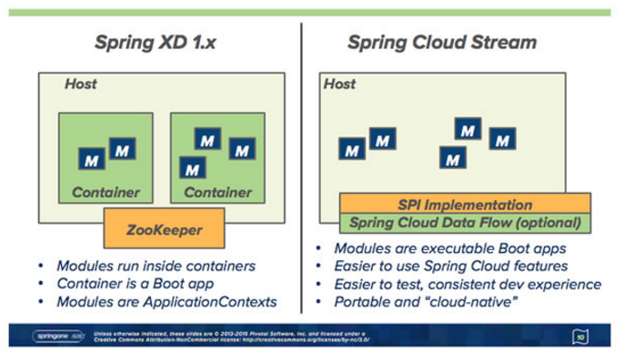
Spring Cloud Data Flow Changes
SPI (Service Providers)
Orchestrate data-centric applications to a variety of modern runtime platforms
Pivotal Cloud Foundry
Apache Mesos
Apache Yarn,
Kubernetes, ….
https://www.infoq.com/news/2015/09/spring-cloud-data-flow
Notes:
Spring XD’s Zookeeper-based runtime is gone,
replaced by a service provider interface or SPI
that delegates to other systems for launching, scaling and monitoring microservice applications.
such as
Pivotal Cloud Foundry,
Lattice, and
Yarn
the existing integration and batch modules have been refactored
to Spring Boot apps with isolated flat classloaders.
In effect the redesign allows stream and batch applications
to run as data microservices that can be independently evolved.
much more straightforward to write unit tests against the stand-alone modules
than when they were run in Zookeeper-based XD Containers

Slide 39
Migrating from Spring XD to Spring Cloud Data Flow
http://docs.spring.io/spring-cloud-dataflow/docs/current-SNAPSHOT/reference/html/migration-guide.html#_shell_dsl_commands
Terminology Changes
Modules -> applications,
Admin UI -> Dashboard
Message Bus -> Binders
Batch/Job -> Task
All channels have pub/sub semantics
All are Topic or Topic-Exchange, no Queues
Shell/DSL is still there
But names in commands have changed
Module -> Microservice App lications
Job -> Task
Notes:
http://docs.spring.io/spring-cloud-dataflow/docs/current-SNAPSHOT/reference/html/migration-guide.html#_shell_dsl_commands

Slide 40
Spring-XD
Big Data Solutions mostly Data Integration issues
Spring XD simplifies this in the Big Data world
For Hadoop simplified the configuration and boilerplate when building Map/Reduce and other YARN queries
Familiar and massively scalable
But Had Limitations
Not compatible with modern S/W engineering methods like TDD, CD, DCC
XD Monolithic architecture hard to maintain, starting to show code rot
Tight coupling with lots of dependencies
Needed reimagining for accelerated development and affinity for the cloud
Spring Cloud Data Flow
Shift to a modular loosely couple component architecture
Can run Spring Cloud Stream and Spring Cloud Task as standalone artifacts
Ideal for cloud native architecture
Notes:
Spring XD rebranded to Spring Cloud Data Flow
Flow is the reincarnation of Spring XD with a strong focus towards microservices and cloud native architecture patterns.
Rearchitecure
orchestrating Spring Boot applications as composite units of deployment
running in Cloud Foundry’s Lattice (now deprecated).
designed the initial version of an application deployer Service Provider Interface (SPI)
serve as the gateway to deploy Spring Boot applications to the Diego runtime.

Slide 41
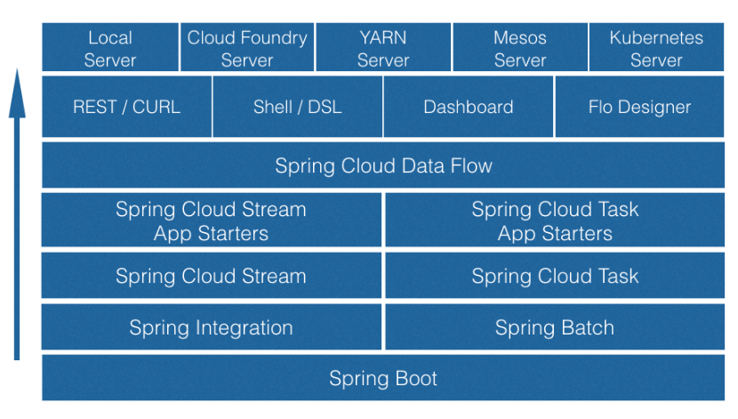
Building Blocks of Spring Cloud Data Flow
https://www.cloudfoundry.org/data-goes-cloud-native-with-the-new-spring-cloud-data-flow/
Notes:
Spring Cloud Stream = Spring Integration meets Spring Boot
Evolves into a lightweight event-driven microservices framework
Rapid development of event-driven microservice applications that can connect to external systems

Slide 42
What Have We Learned?
Spring Core Review
What is the Spring Framework?
Spring Architecture
Introduction to Gradle
Advantages
Groovy and Build Files
Tasks, Plugins, and Dependency Management
Introduction to Spring Boot
What is Spring Boot?
Starter Projects
Autoconfiguration
Building and Running
Additional Spring Boot Topics
Starter Dependencies
Auto Configuration
Deploying a WAR
Spring Remoting and JMS
RMI and Spring
HttpInvoker and Spring
Messaging with JMSTemplates and Spring
Introduction to Spring Batch
Spring Batch Application Concepts
Structure and Configuration
Enterprise Integration Patterns
Overview
EIP Categories
Spring Integration
Components, Channel, and Service Activation
Messaging Gateway
Spring Integration Messages and Channels
Direct, Publish Subscribe, and Queue Channels
Integration Endpoints
Messaging, Inbound, and Outbound Endpoints
Gateways and Routers
Splitters, Aggregators, Filters, and Transformers
Introduction to Hadoop
HDFS
MapReduce
YARN
Introduction to Spring XD
Streams, Sources, and Sinks
Processors and Tags
Tools
Spring XD Modules
Sources, Sinks, and Processors
Taps, Counters, and Guages
XD Jobs
Notes:
SETUP: Have open in browser
Lab 7 ExtraInfoLap07MsgFlow.jpeg,
Direct student to it in their lab manuals
BEFORE starting 1st modules, Spring Integration Endpoints
ExtraInfoMapReduceDiagram: needed for Hadoop module
Spring XD have server and cmd up and running (see setup for lab 8)
So can do a "module list" command to see available modules
Leave it up to show it while going through each slide in Spring XD Module Overview
Websites:
Haddop Google paper bad link in mats: good link at https://static.googleusercontent.com/media/research.google.com/en//archive/mapreduce-osdi04.pdf
Haddop History table at : https://en.wikipedia.org/wiki/Apache_Hadoop
Spring SD Sources : http://docs.spring.io/spring-xd/docs/1.3.0.RELEASE/reference/html/#sources
Spring SD Sinks: http://docs.spring.io/spring-xd/docs/1.3.0.RELEASE/reference/html/#sinks
Video:Martin Fowler at GO 2012 overview of NoSQL databases
Start at 9:36
End when done with aggregate types of databases
https://www.youtube.com/watch?v=qI_g07C_Q5I

Slide 43
